Slide 1
Chef Fundamentals
Signing up for a Hosted Chef Account
Part number- Chef-Fund-1.0.0
Notes:
SD: See part number.

Slide 2
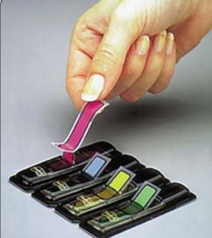
Objectives
After completing this module, you should be able to:
Sign up for a Hosted Chef account
Reset your Validation Key
Download the knife application

Slide 3
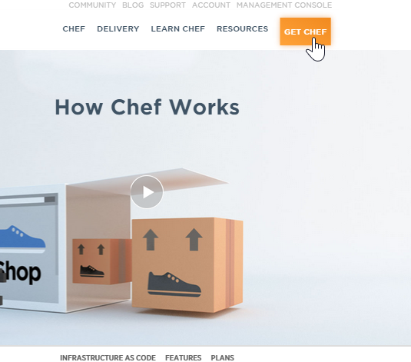
Signing Up for a Hosted Chef Account
Steps
Navigate to https://www.chef.io/chef/
From the resulting window, click Get Chef.

Slide 4
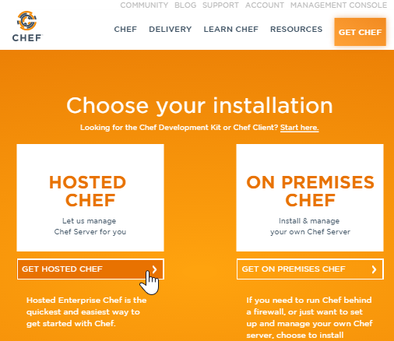
Signing Up for a Hosted Chef Account
Steps
From the resulting window, click the Get Hosted Chef button.

Slide 5
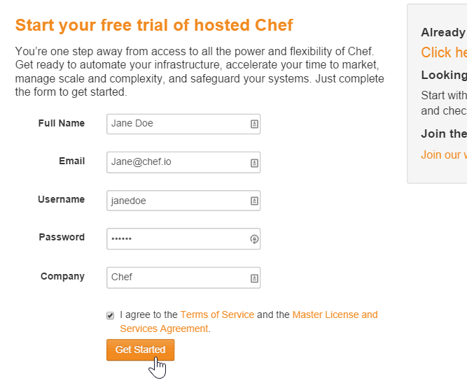
Signing Up for a Hosted Chef Account
Steps
Fill out the form as indicated in this image using your name and a valid email address and then click Get Started.
Note: You should write down your new user name and remember your password.

Slide 6
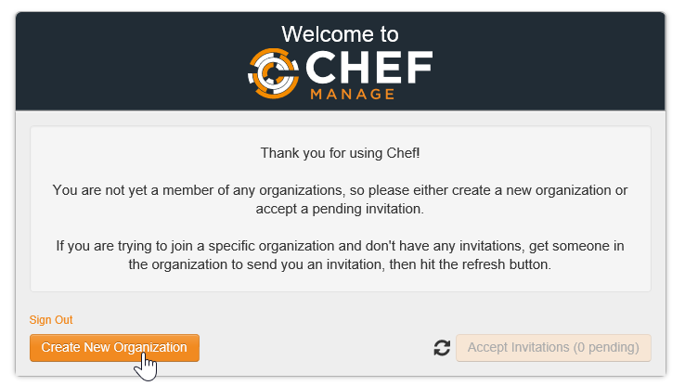
Signing Up for a Hosted Chef Account
Steps
From the resulting page, click the Create New Organization button.

Slide 7
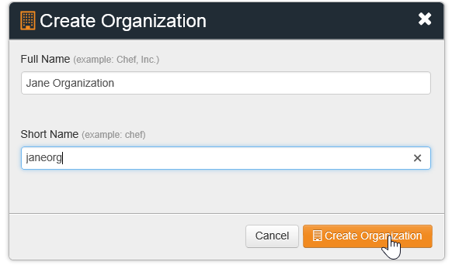
Signing Up for a Hosted Chef Account
Steps
Fill out the resulting Create Organization form and then click Create Organization.

Slide 8
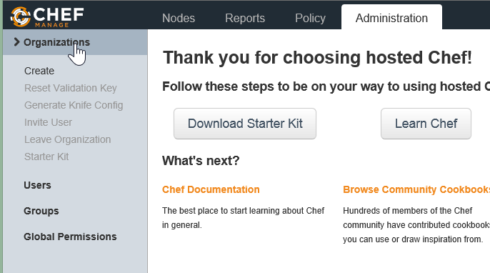
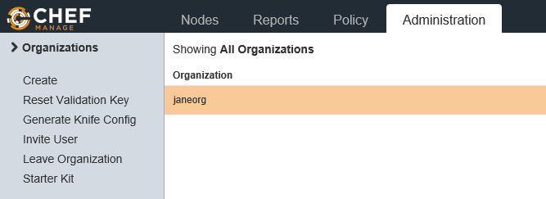
Signing Up for a Hosted Chef Account
Steps
From the resulting page, click the Organizations link to see your new organization.

Slide 9
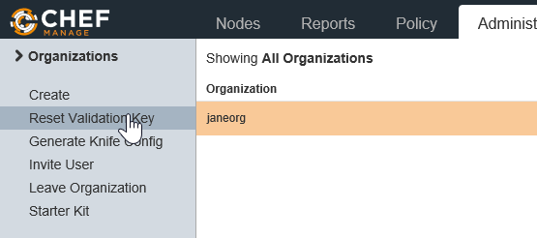
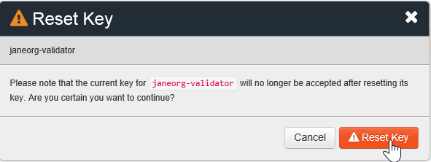
Signing Up for a Hosted Chef Account
Steps
Click the Reset Validation Key link to reset the validation key that you set in the preceding Chef Fundamentals class.
From the resulting Reset Key window, click the Reset Key button.

Slide 10
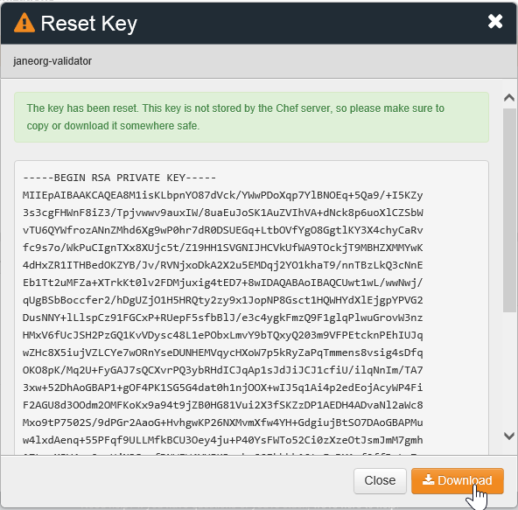
Signing Up for a Hosted Chef Account
Steps
From the resulting Reset Key window, click the Download button.
After downloading, copy the new key to your local chef-repo > .chef directory on your workstation.

Slide 11
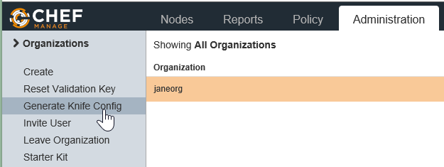
Signing Up for a Hosted Chef Account
Steps
From the remaining window, click Generate Knife Config.
After downloading the knife file, copy it to your local chef-repo > .chef directory on your workstation.

Slide 12
Summary
In this module, you learned how to:
Sign up for a Hosted Chef account
Reset your Validation Key
Download the knife application
What questions can we answer for you?

